Slide 1
Data Acquisition and Data Wrangling
Data acquisition refers to the procedure of obtaining information by downloading or transferring files from one location to another. File transfer, FASTA manipulation, manipulating Excel data sheets, and data management are the four primary sections of data acquisition.
Data wrangling is a time-consuming and iterative process of preparing and enriching data for analysis and visualization. Data preparation is the term for a procedure of data analysis like this. If the data wrangling system' output contains new data or errors, this procedure, like data analysis itself, can be iterative This implies that the program sequences may be repeated until the preferred outcome is obtained. Data wrangling is a simple and straightforward process compared to data curation or data stewardship, which are much more complex and difficult. Data curation is a holistic process that defines the continuous management of data throughout its whole life cycle from creation and first storage to the spot in time when it is archived or outdated and removed for future analysis.
By: Navdeep Kohar

Slide 2
About Project
• Data acquisition
• Different methods for data wrangling:
Merge datasets
Identify unique values
Drop unnecessary columns
Check the dimensions of the dataset
Check the datatype of the dataset
Check datatype summary
Treat missing values 8. Validate the correctness of the data at the primary level if applicable

Slide 3
Tool & Technology
Tools – Python
Python Libraries- NumPy & Pandas
• Pandas is a high-level data manipulation tool
• NumPy is used for working with multidimensional
Juypter Notebook - It is a web-based interactive computing platform. The notebook combines live code, equations, narrative text, visualizations,

Slide 4
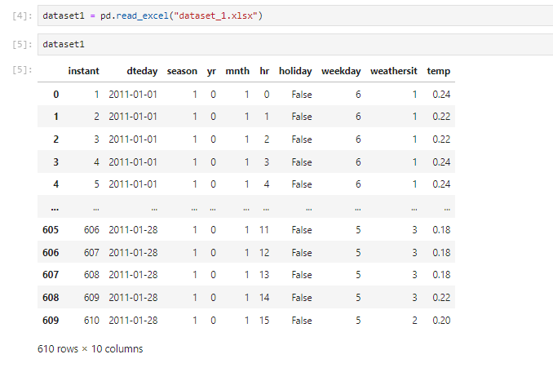
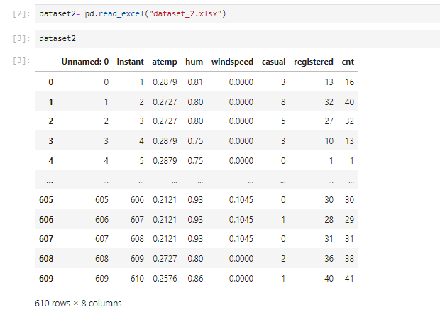
Datasets 1 & 2

Slide 5
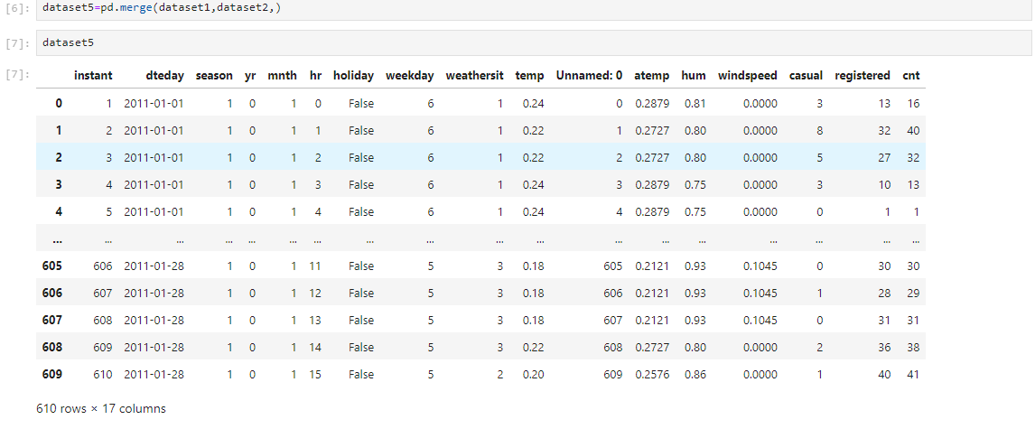
Merge Datasets

Slide 6
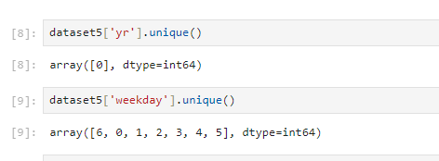
Unique Values

Slide 7
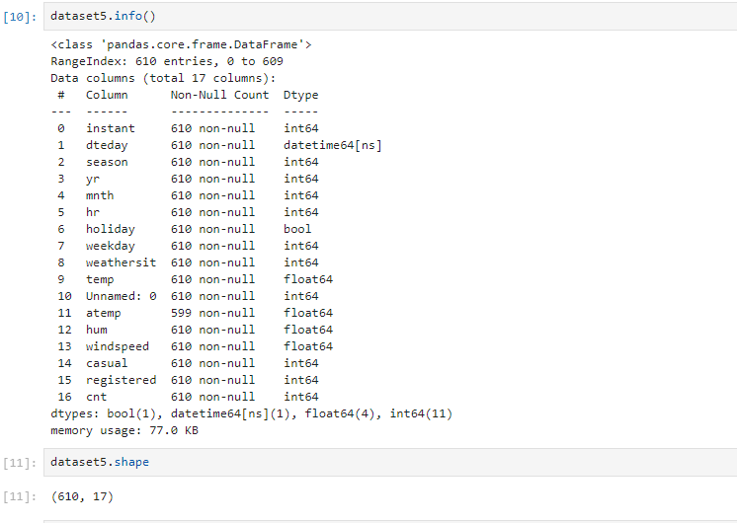
Dimension Of Dataset & Datatype

Slide 8
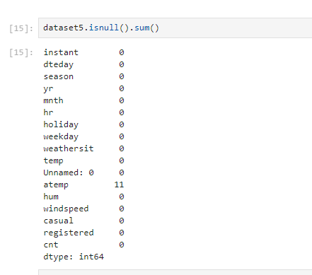
Dataset Missing Values

Slide 9
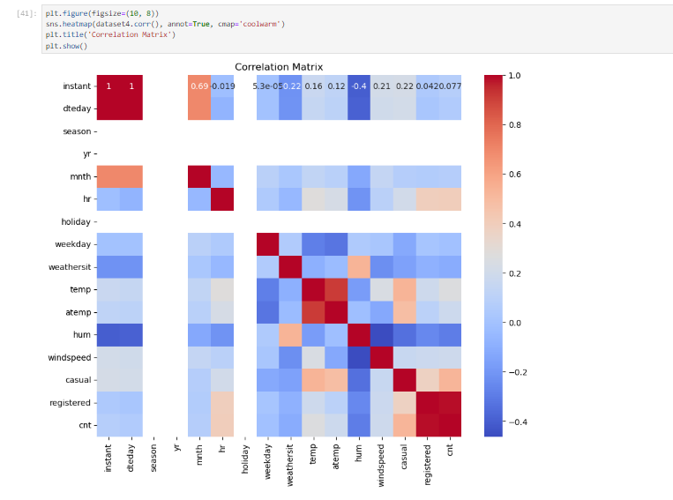
Correlation of the data

Slide 10
Conclusion
Overall, data wrangling plays a crucial role in your overall data management process, transforming raw data into a valuable asset for your organization, helping you extract meaningful insights and make informed business decisions based on high-quality data.
Data wrangling ensures data is reliable and complete before professionals analyse it and use it to create insights. Thanks to this process, those insights are based on accurate, high-quality data
Effective data collection allows organizations to identify areas of improvement, measure success, and guide future decision-making. It plays a crucial role in understanding the competitive landscape.

Slide 11
Thank You
Name-Navdeep Kohar
Mail-navdeepkohark58@gmail.com
Ph - 9888339255

